Slide 1
FISH N’ CHIPS
BY: Mitchell Filion

Slide 2
Key Concepts
Players will begin by entering their names
Each player takes 3 turns to catch the biggest fish possible
The turn consists of a player selecting an element within our “pond” to try to catch a fish
The Score (Size of Fish) will be displayed
Game will compare scores and display the winner
“Rematch?” Button will appear
Local Storage will save a leaderboard of the “Local Legends”

Slide 3
Process / Functionality
Player 1 and 2 enter their names
Players will select an element within the “pond” table on each turn
When an element is selected, a random fish with a random size will be provided
Players have 3 turns before the game ends
Once the game ends, end results are compared and winner is displayed
“Rematch?” Button Local Storage will provide key features like the ability to exit and re-enter the page without losing information. A High score feature will most likely be implemented as well.

Slide 4
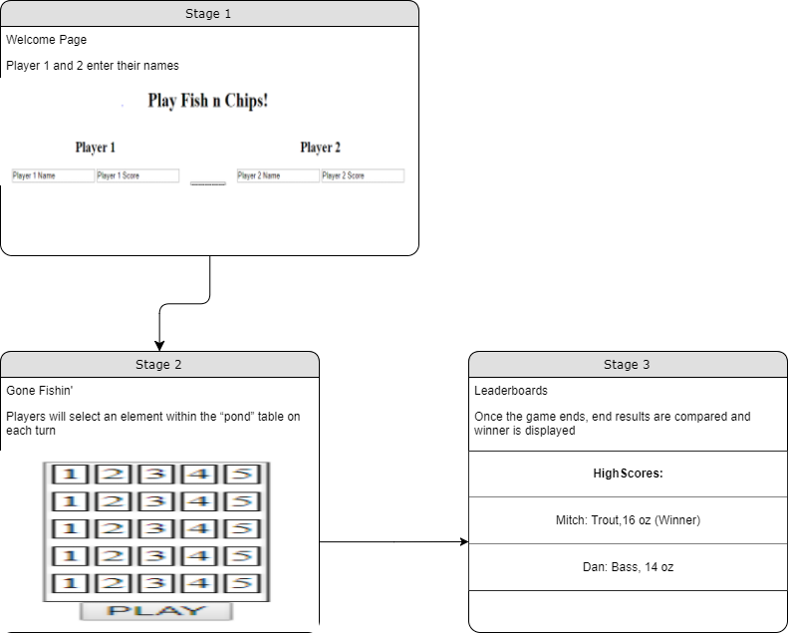
Event Panel

